Slide 1

Bank Customer Churn Analysis
Why Are Customers Leaving?
A Data-Driven Analysis of Bank Customer Churn
Edward Agyemang
Master of Professional Studies in Data Analytics
Northeastern University, Vancouver Campus
ALY 6000 — Project 4A | 2024

Slide 2





The Cost of Customer Churn
Customer churn is one of the most expensive problems in the financial industry. Understanding who's at risk allows banks to act early.
20.4% Churn Rate
1 in 5 customers already left
20.4%
5x Acquisition Cost
More expensive to acquire than retain
Overall Churn Rate
Revenue Impact
Direct effect on annual income
2,037 of 10,000 customers
Targeted Retention
Early intervention significantly reduces losses

Slide 3



Dataset Overview
10,000
Customers
Key Variables
France • Germany • Spain
Credit Score
Geography
3 countries
Gender
Age
Tenure
Balance
11
0
Number of Products
Credit Card Status
Active Member Status
Estimated Salary
Variables
Missing
Exited (Target)
Target Variable
Exited (Churned/Stayed)

Slide 4
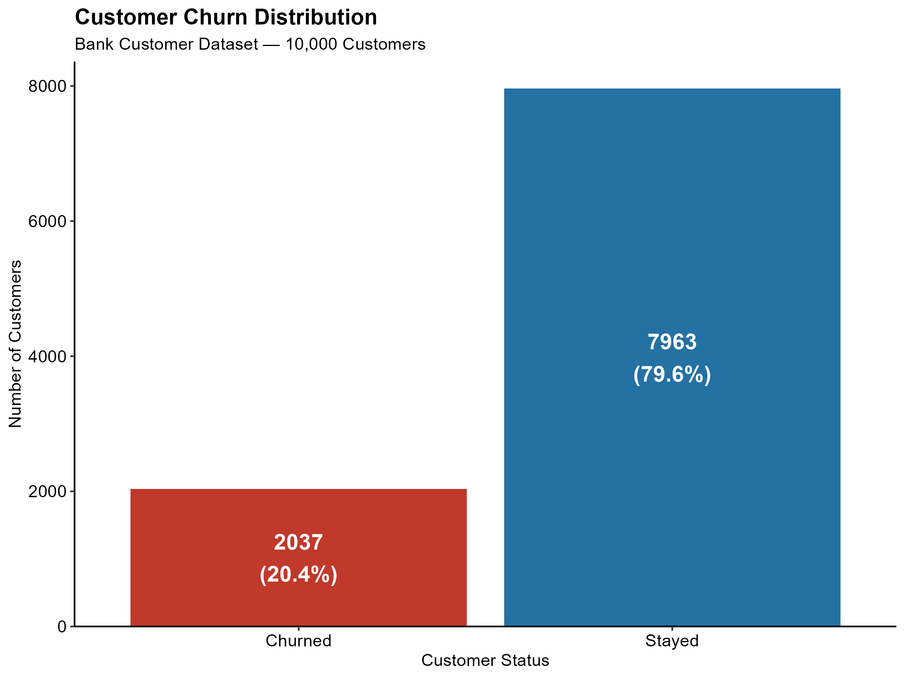

Finding 1: The Scale of the Problem
20.4%
Overall Churn Rate
1
2,037 customers left
Out of 10,000 total
2
Industry benchmark
Healthy churn: below 5-10%
3
Revenue impact
Potential $2M lost annually

Slide 5
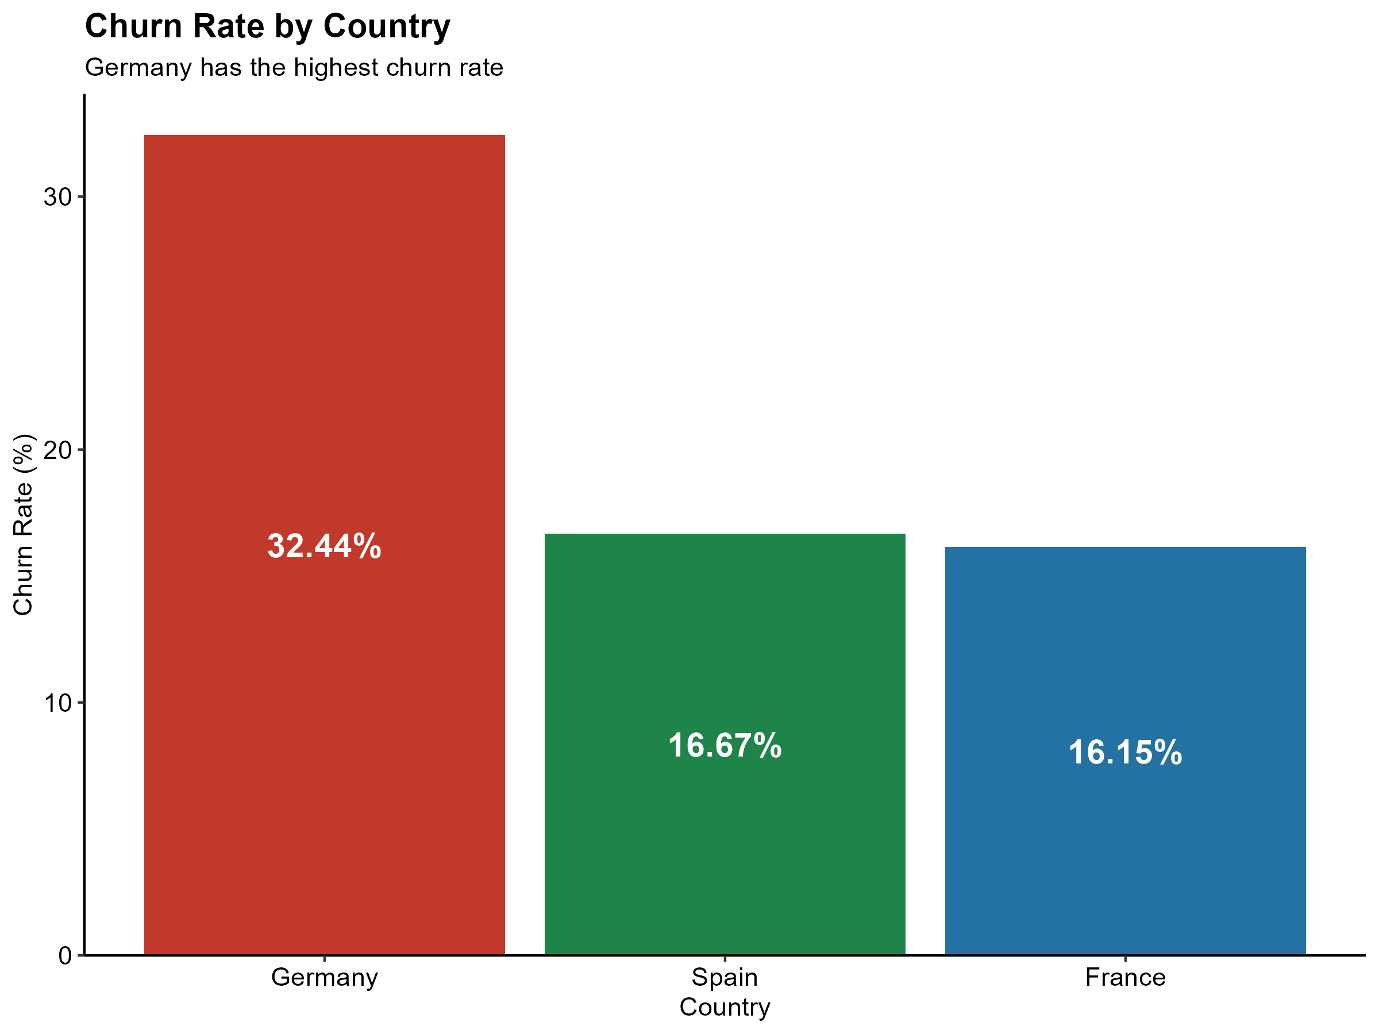



Finding 2: Germany Has a Serious Problem
Germany
32.44%
churn rate
Nearly 2x higher than France & Spain
France
Spain
16.15%
16.67%
25% of customer base
2,509 customers
Disproportionate churn
Requires immediate investigation

Slide 6
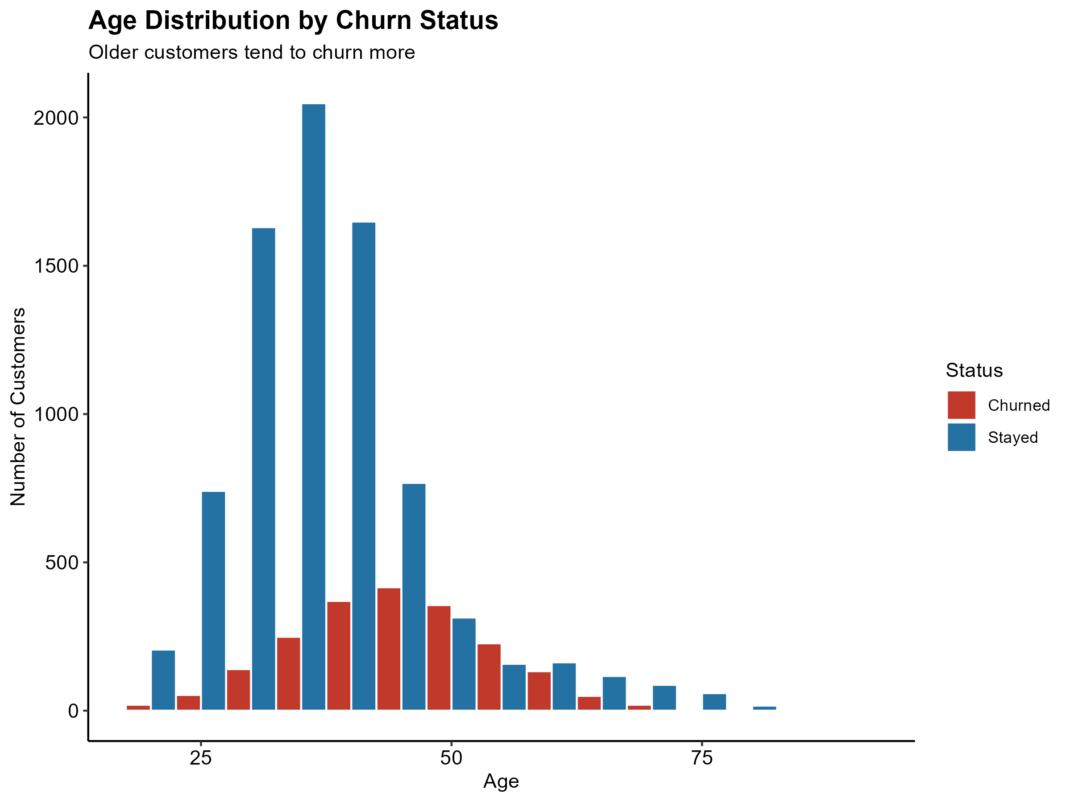





Finding 3: Age is the Strongest Predictor
Churned
Stayed
44.8
years
37.4
years
Age Gap
Statistically
7 years
significant
Churn rises after age 45
Notable increase in red bars
Middle-aged customers at risk
Consolidating finances or retiring

Slide 7
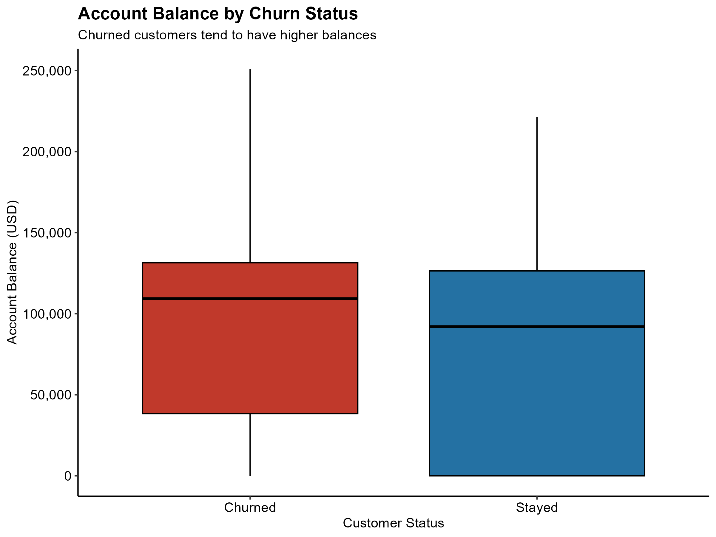




Finding 4: Churned Customers Have More Money
Churned
$91,109
Avg account balance
Stayed
$72,745
Avg account balance
Difference
$18,364
Bank is losing its most valuable customers

Slide 8




Finding 5: Inactive Members Leave More Often
Churn Rate by Membership Activity
Inactive members are far more likely to churn
Inactive
Active
26.85%
14.27%
churn
churn
Active Members
Inactive Members
2x
Churned
Churned
Churn Rate
Higher for inactive
14.27%
26.85%
Directly controllable
Stayed
Stayed
Banks can influence activity level
Highest leverage action
85.73%
73.15%
Re-engagement campaigns work
Churned
Stayed

Slide 9
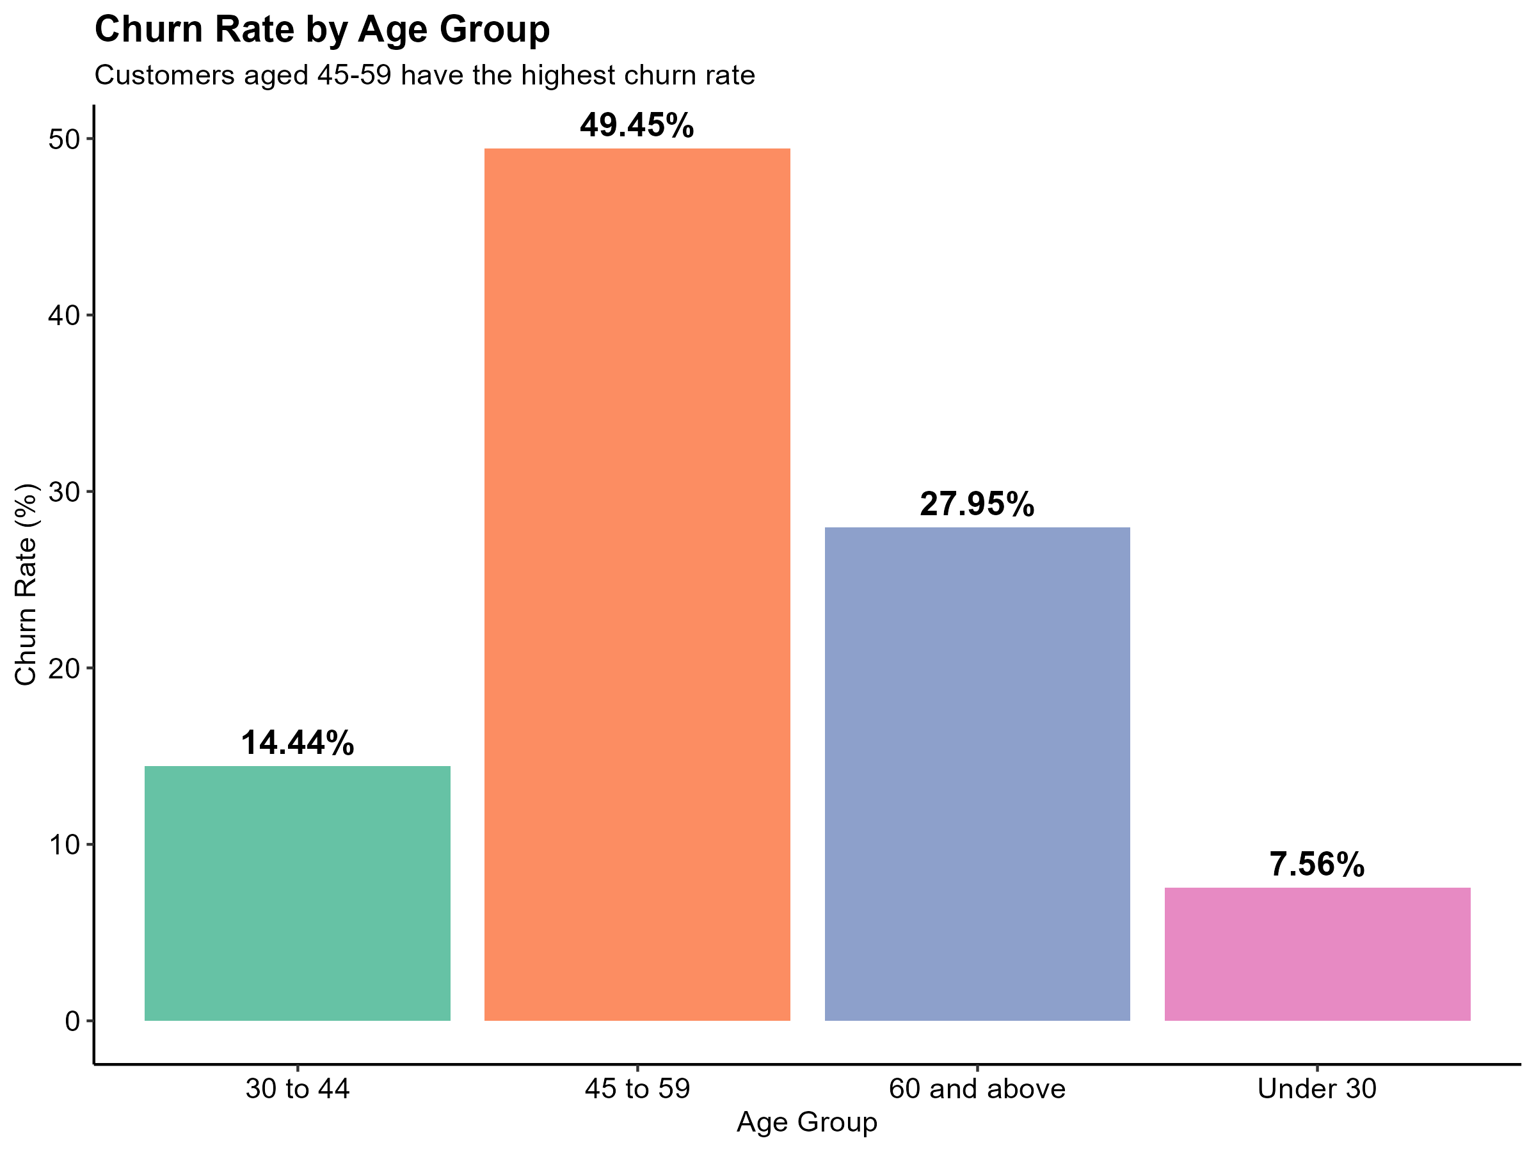




Finding 6: The 45-59 Age Group is Highest Risk
45-59 Age Group
49.45%
churn rate
Nearly half left the bank
Under-30 Group
7.56%
churn rate
Most loyal customers
6.5x higher churn
45-59 vs under-30
Clear age gradient
Products fail older customers

Slide 10
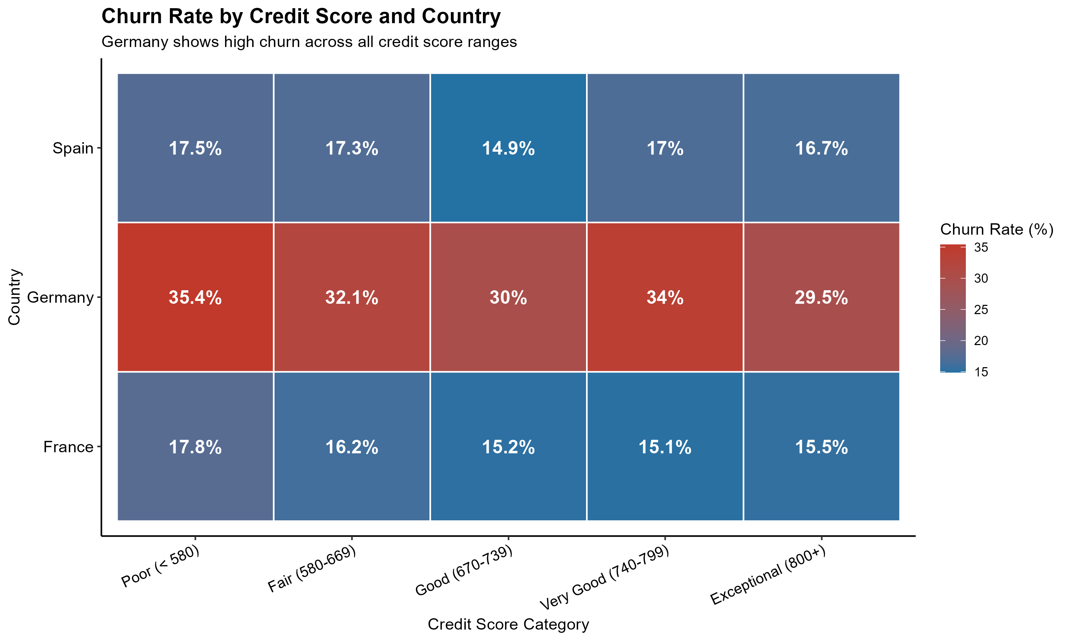





Finding 7: Germany's Problem Runs Deep
Germany + Exceptional Credit
29.5%
churn rate
France + Poor Credit
17.8%
churn rate
Credit score doesn't matter
German churn is structural
Market-level problem
Competition or pricing issue

Slide 11
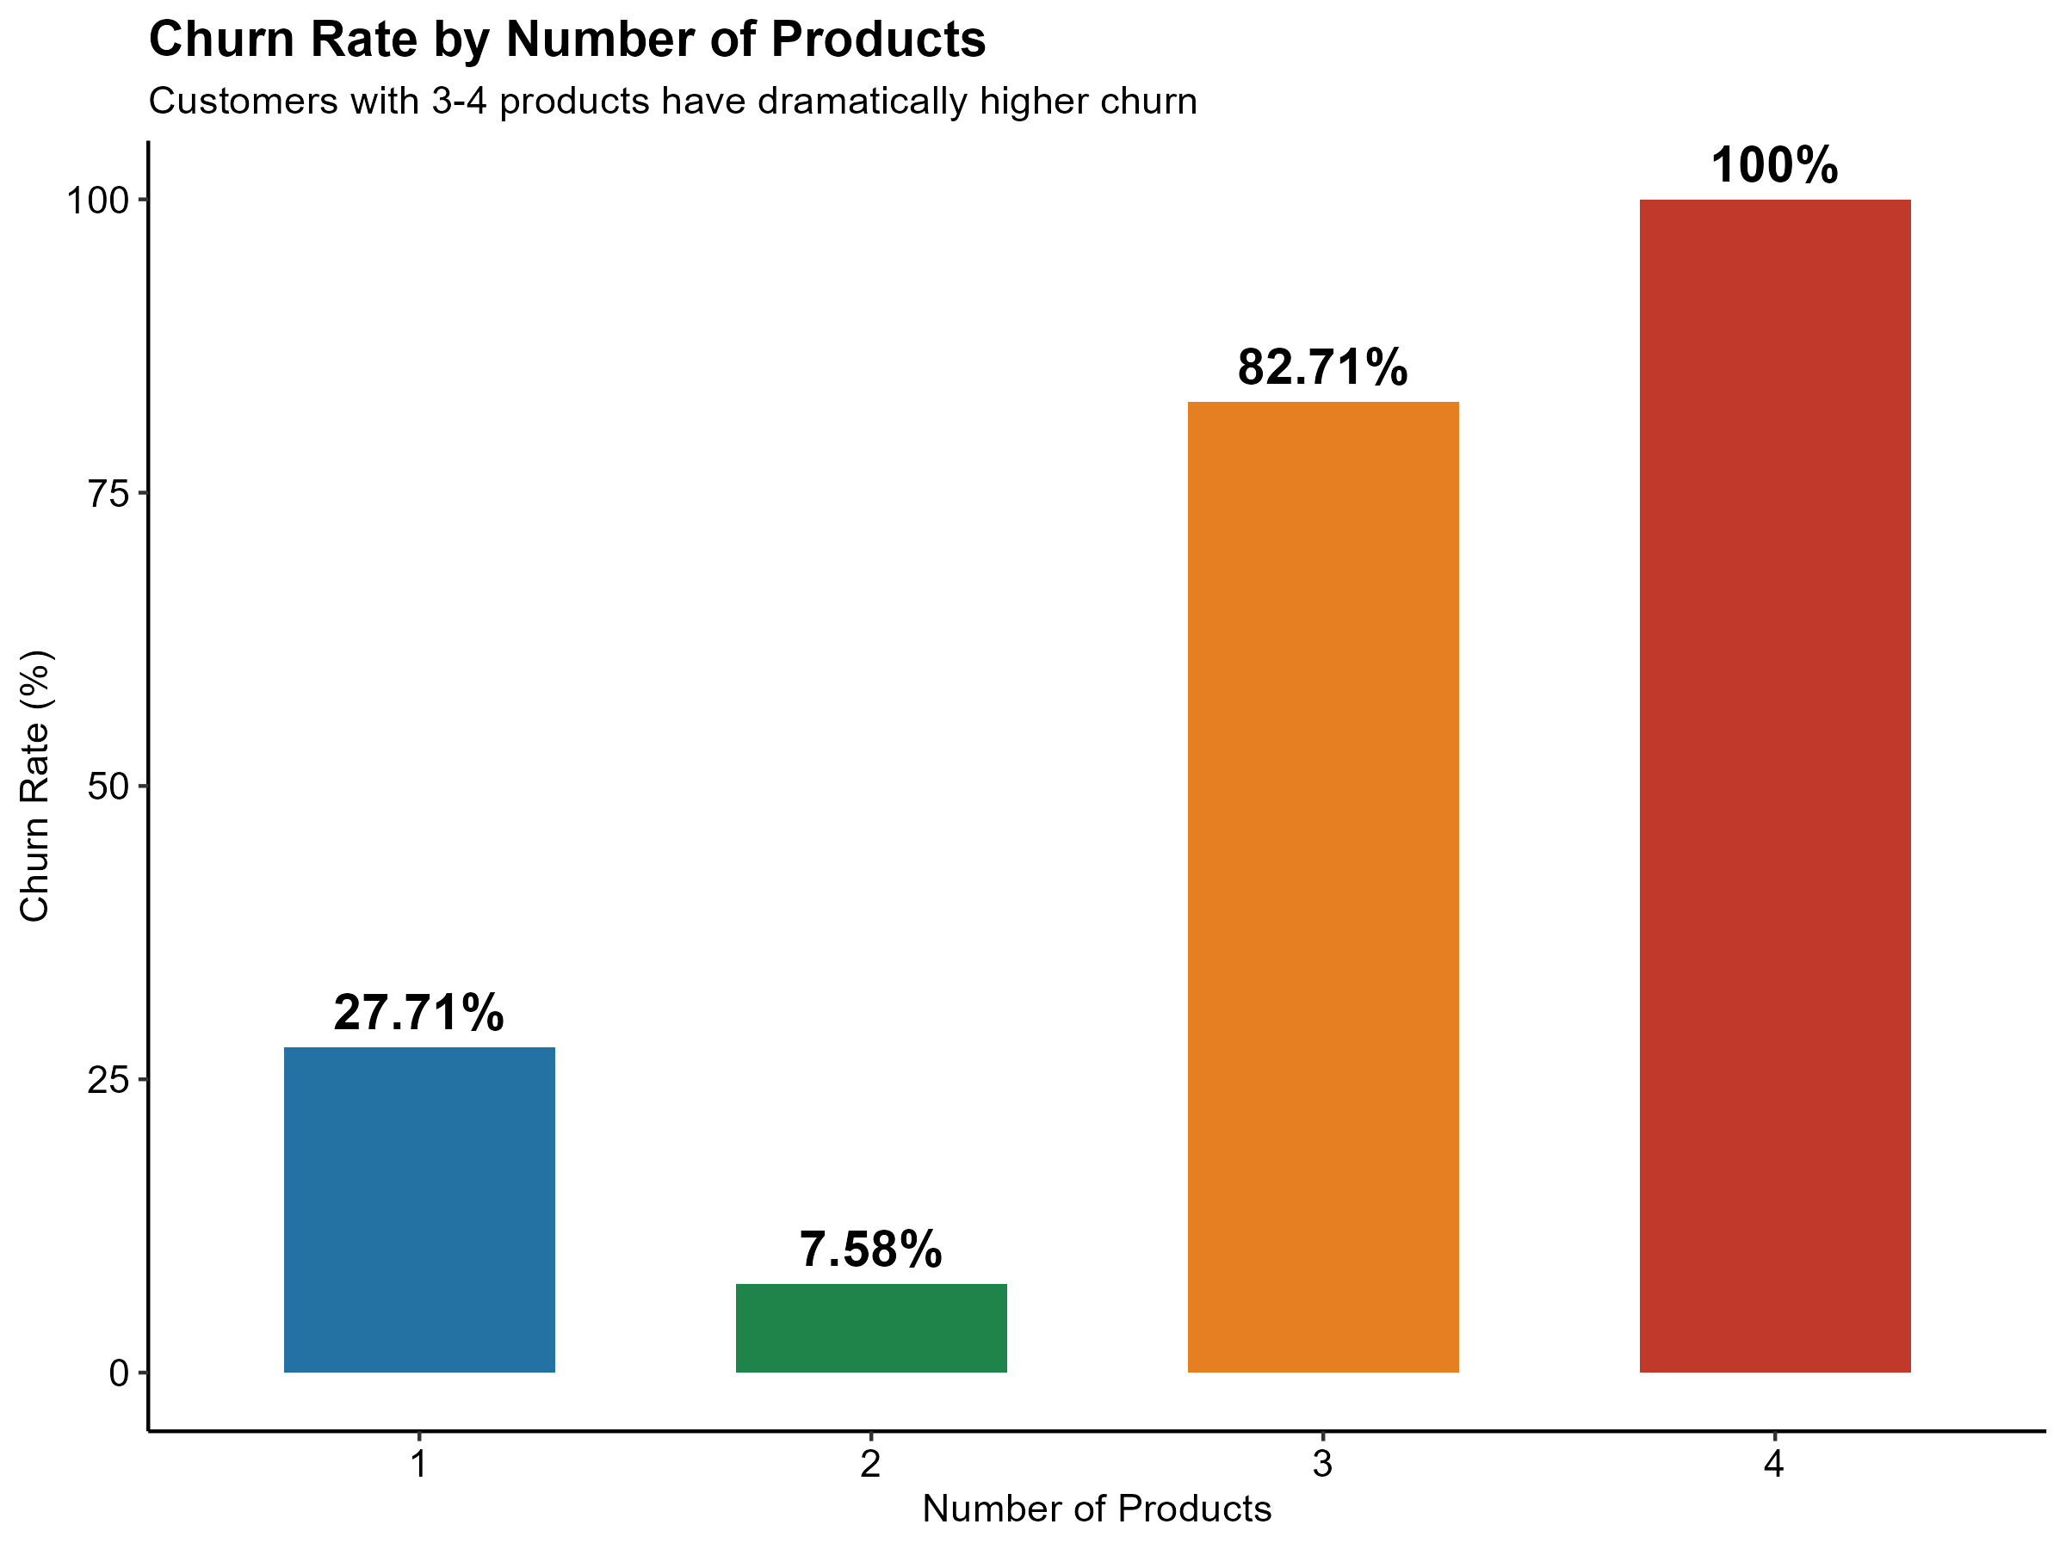






Finding 8: A Shocking Product Paradox
4 Products
3 Products
100%
82.71%
All left
Most left
2 Products = Optimal
7.58%
churn rate
More products ≠ more loyalty
Over-selling creates resentment
Customers feel trapped

Slide 12







The High-Risk Customer Profile
Average Age
Churned
Stayed
Difference
44.8 years
37.4 years
+7 years
Average Balance
Most Likely to Churn
Churned
Stayed
Difference
$91,109
$72,745
+$18,364
Female
Mid-40s (avg 44.8 years)
German customer
% Female
High balance ($91k+)
Churned
Stayed
Difference
55.9%
42.7%
+13.2%
Inactive member
% Germany
Valuable customers quietly slipping away - not problem customers
Churned
Stayed
Difference
40.0%
21.3%
2x higher
% Inactive
Churned
Stayed
Difference
63.9%
44.5%
+19.4%

Slide 13





Key Recommendations for Action
1
Urgent Attention Needed
4
Age-Specific Retention
Address 20.4% overall churn rate - represents significant revenue loss
Create dedicated product for 45-59 age group (49% churn rate)
5
Review Product Bundling
2
German Market Investigation
Avoid over-selling - customers with 3+ products churn at 82%+
Dedicated intervention strategy required for 32% churn rate
Take Action Now
3
Re-engagement Campaigns
Prioritize inactive members and German market for immediate impact
Target inactive members - highest leverage action available

Slide 14
Future Research Directions
1
Credit Score Threshold Effect?
2
Inactivity Root Causes
Does credit score truly not matter for German customers, or is there a threshold effect?
Are inactive members inactive by choice, or because the bank's digital experience is poor?
3
Product Composition Analysis
4
Tenure & Loyalty Relationship
What specific products do 3-4 product customers hold that correlate with churn?
How does churn vary by tenure — do long-term customers eventually become more loyal?
5
Predictive Modeling Opportunity
Can a predictive churn model flag at-risk customers 3-6 months before they leave?

Slide 15






Thank You
Data-Driven Insights for Better Customer Retention
20.4% Churn Rate
German Market Crisis
Demands immediate action
32% churn rate
Inactive Members
Strong Predictors
Highest leverage opportunity
Age & product complexity
Retention Strategy Must Be Targeted, Not Broad
Focus on high-risk segments with the greatest potential impact
e.agyemang@northeastern.edu
Northeastern University, Vancouver

